Slide 1
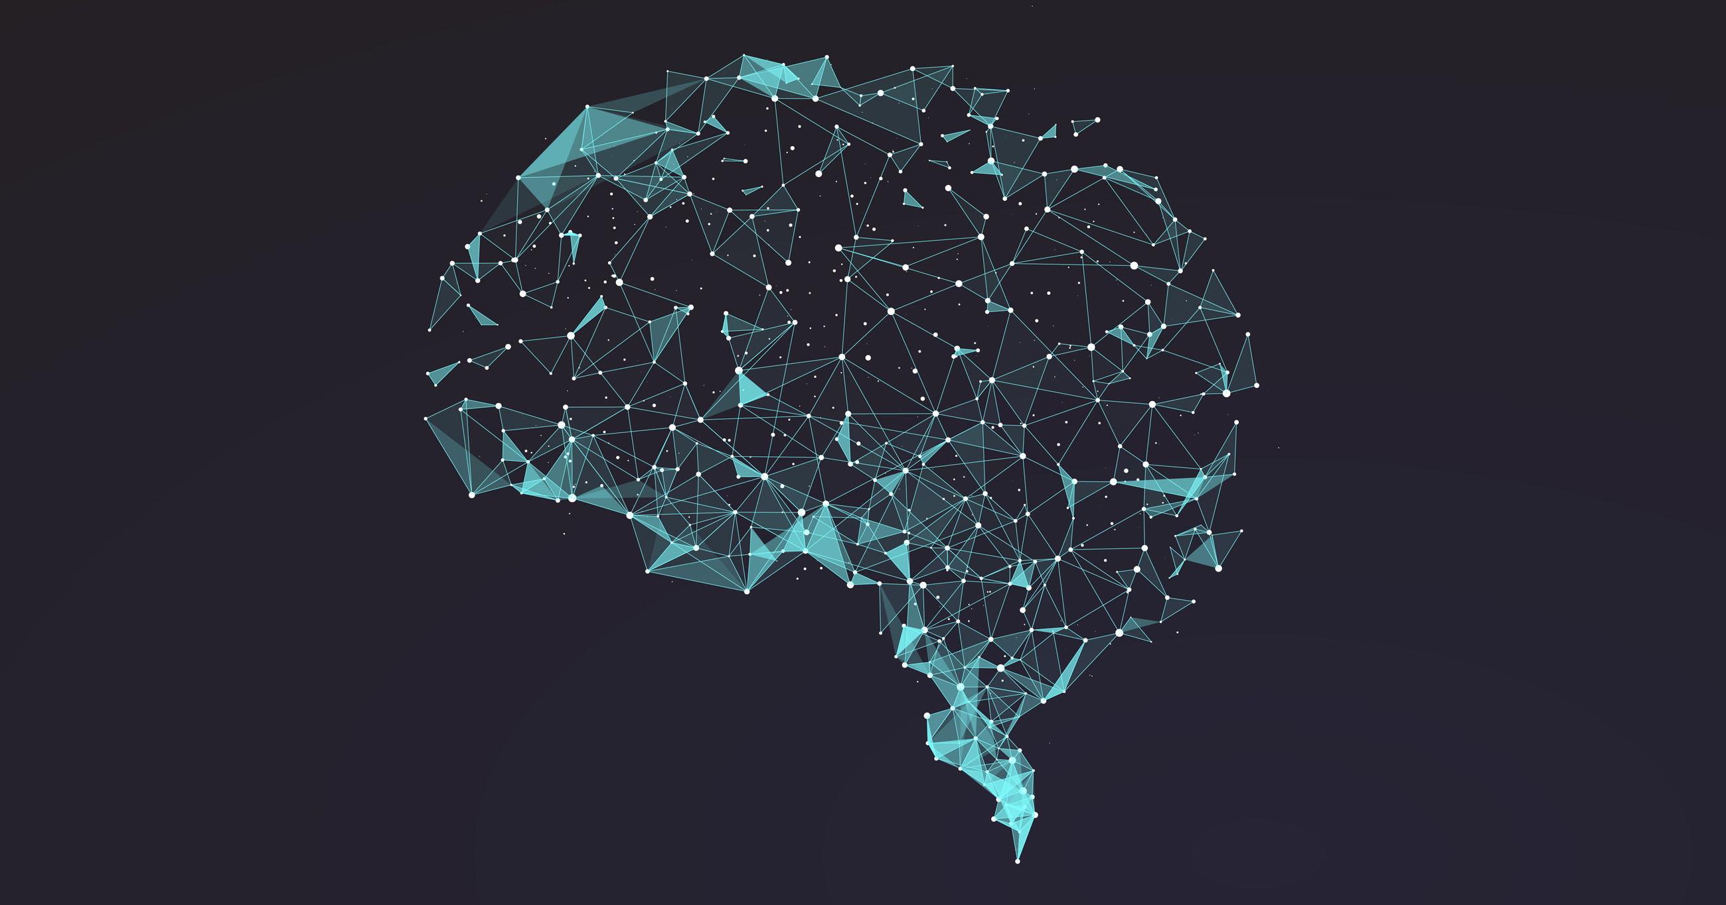
Masterclass
Neural Networks

Slide 2
Use Cases

Slide 3
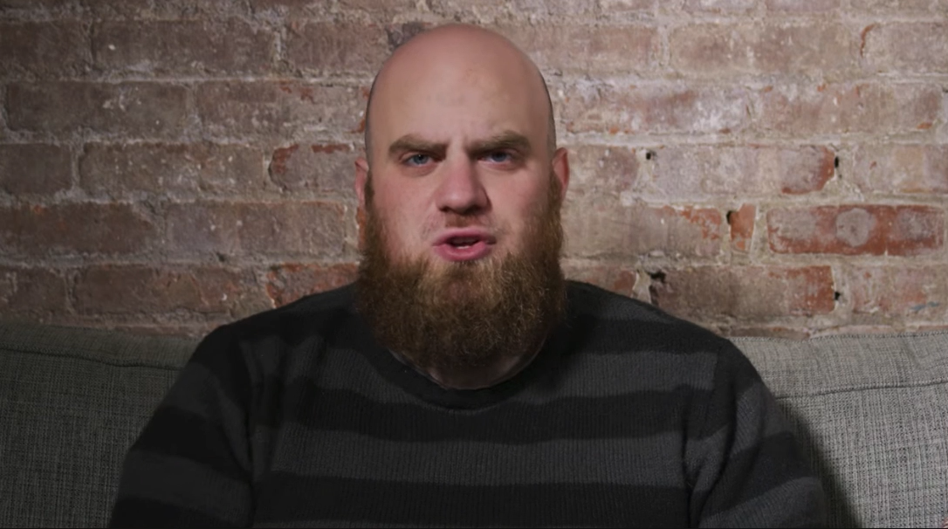

Slide 4
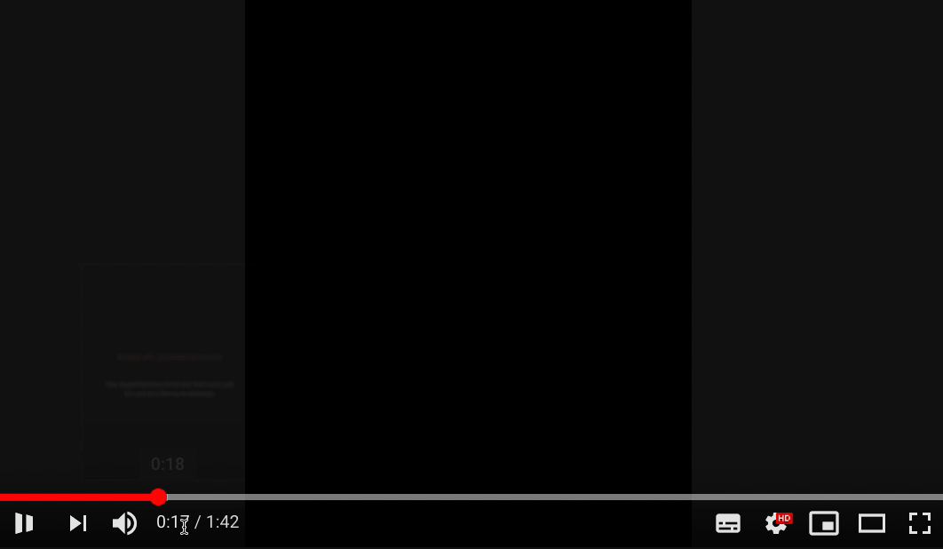

Slide 5
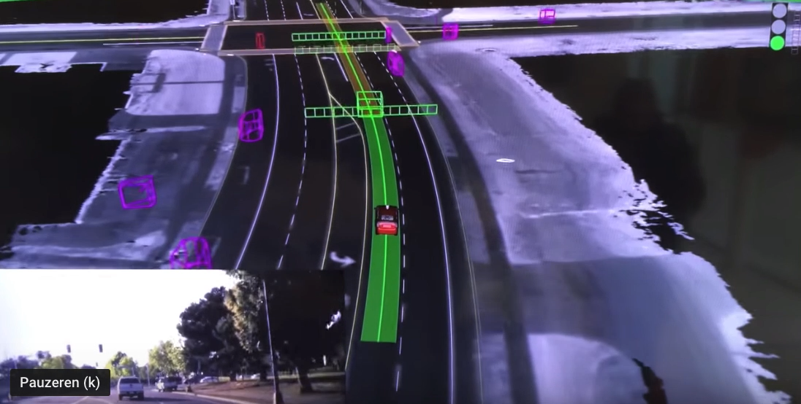

Slide 6
Patterns

Slide 7
Real life
Take your first step
You fall! Learn from this experience
Take another step
Yes!
Neural network
Make a prediction
Wrong! Learn from this experience
Make another prediction
Yes!

Slide 10
Neural
Network

Slide 12
Key-words
Input
Output
Weights
Activations
Learning Rate
Feed forward
Back propagation

Slide 14
HIDDEN
LAYER
INPUT
Red and round
ACTIVATION
0.2
OUTPUT
Color
0
0.6
0 = red
1 = yellow
0.6
WEIGHTS
Fruit
0.4
0.3
Shape
1
0 = long
1 = round
Yellow and long

Slide 15
Red and round
0.2
Color
0
0.6
0 = red
1 = yellow
0.6
Fruit
0.4
0.3
Shape
1
0.3
0 = long
1 = round
Yellow and long

Slide 16
FEED FORWARD
Red and round
0.2
Color
0
0.6
0 = red
1 = yellow
0.6
Fruit
0.4
0.3
Shape
1
0.3
0 = long
1 = round
Yellow and long

Slide 17
Red and round
0.2
Color
1
0.2
0 = red
1 = yellow
0.6
Fruit
0.4
0.3
Shape
0
0 = long
1 = round
Yellow and long

Slide 18
Red and round
0.2
Color
1
0.2
0 = red
1 = yellow
0.6
Fruit
0.4
0.3
Shape
0
0.4
0 = long
1 = round
Yellow and long

Slide 19
Red and round
0.2
Color
1
0.2
0 = red
1 = yellow
0.6
Fruit
0.4
0.3
Shape
0
0.4
0 = long
1 = round
Yellow and long

Slide 21
Red and round
0.7
Color
1
0.7
0 = red
1 = yellow
0.2
Fruit
0.6
0.6
Shape
0
0 = long
1 = round
Yellow and long

Slide 22
Red and round
0.7
Color
1
0.7
0 = red
1 = yellow
0.2
Fruit
0.6
0.6
Shape
0
0.6
0 = long
1 = round
Yellow and long

Slide 23
Red and round
0.7
Color
1
0.7
0 = red
1 = yellow
0.2
Fruit
0.6
0.6
Shape
0
0.6
0 = long
1 = round
Yellow and long

Slide 24
LEARNING RATE
BACK PROPAGATION
Red and round
0.7
0.5
Color
1
0.7
0 = red
1 = yellow
0.2
Fruit
0.6
0.8
0.6
Shape
0
0.6
0 = long
1 = round
Yellow and long

Slide 25
Red and round
0.5
Color
1
0.5
0 = red
1 = yellow
0.2
Fruit
0.8
0.6
Shape
0
0.8
0 = long
1 = round
Yellow and long

Slide 26
Let’s do this!

Slide 27
Input |  | Output
0 | 0 | 0
1 | 0 | 1
0 | 1 | 1
1 | 1 | 0
Neural Networks

Slide 28
Recap
Learning similar to human learning
Mathematics
Neural Network Parts:
Nodes
Layers
Weights (+ biases)
Feed forward
Back propagation

Slide 29
What’s next?

Slide 30
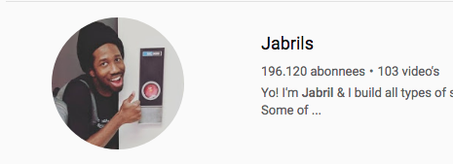

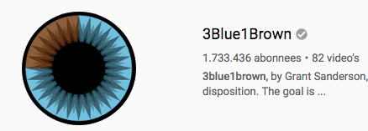
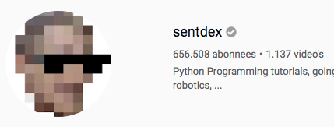

Slide 31
Thank you

